Slide 1
General Linear
Test Approach
We will explain the general linear test approach in terms of the simple linear regression model and testing H_{o}: β₁ = 0 vs H_{a}: β₁ ≠ 0.
The general linear test approach involves three basic steps: the full model, the reduced model, and the test statistic.
We begin with the model considered to be appropriate for the data, which is called the full or unrestricted model.

Slide 2

General Linear
Test Approach
For simple linear regression, the full model is the normal error regression model
We fit the full model by either the method of least squares or by the method of maximum likelihood, and obtain the error sum of squares.
The error sum of squares is the sum of the squared deviations of each observation Y_{i} around its estimated expected value.
In this context, we denote the error sum of squares by SSE(F) to indicate that it is the SSE for the full model.

Slide 3
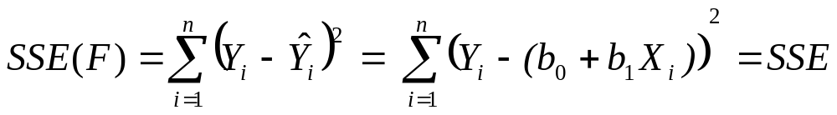
General Linear
Test Approach
For the case of the simple linear regression model, the SSE for the full model is
Thus, for the case of the simple linear regression model, the SSE for the full model is simply the regular SSE.
The model when H_{o} is true is called the reduced or restricted model.
It is reduced or restricted by the null hypothesis.

Slide 4

General Linear
Test Approach
Our hypotheses are: H_{o}: β₁ = 0 vs H_{a}: β₁ ≠ 0.
When the null is true, that is when β₁ = 0, our model reduces to
As with the full model, we fit this reduced model by either the method of least squares or by the method of maximum likelihood, and obtain the error sum of squares, now denoted by SSE(R).
When we fit this model, both the least squares and maximum likelihood estimator of β₀ is Y(bar).

Slide 5
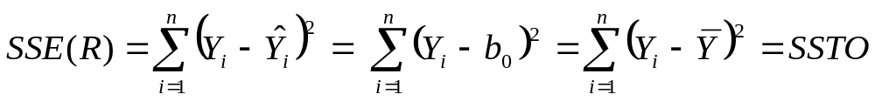
General Linear
Test Approach
Thus, for the case of the simple linear regression model, the expected value of each observation is b₀ = Y(bar) and the error sum of squares for the reduced model is
We will now compare the two error sums of squares SSE(F) and SSE(R).
Note that SSE(F) ≤ SSE(R). This is intuitive since the more parameters in the model, the better the fit of the data and the smaller the deviations.

Slide 6
General Linear
Test Approach
The error sums of squares are measures of the total variability left unaccounted for by the model. So the more variability accounted for by the model, the smaller the error sums of squares.
When SSE(F) is not much less than SSE(R), the full model does not account for much more of the variability than the reduced model.
Another way of looking at this is that the variation of the observations around the regression function for the full model is not much less than the variation of the observations around the regression function for the reduced model.
In that case, the data suggest that the reduced model is adequate (we would not reject H_{o} ).

Slide 7
General Linear
Test Approach
However, a large difference between SSE(F) and SSE(R) suggests that the reduced model is not adequate.
The additional parameters in the model do substantially reduce the variation of the observations around the regression function.
That is, the full model does account for much more of the variability than the reduced model.
Therefore we use a test statistic that is a function of SSE(R) – SSE(F).

Slide 8
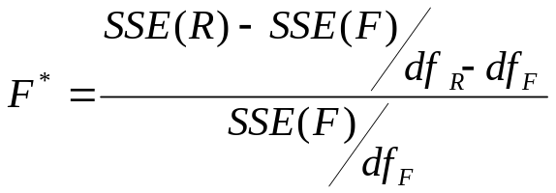
General Linear
Test Approach
For the general linear test, we define F* as
which follows an F distribution when H_{o} is true.
The terms df_{R} and df_{F} denote the corresponding df for SSE(R) and SSE(F).
Large differences between SSE(R) and SSE(F) lead to large values of F*, so we reject the null when F* is large.

Slide 9
General Linear
Test Approach
The decision rule is:
If F* ≤ F(1-α:, df_{R} – df_{F}, df_{F} ), fail to reject H_{o}
If F* > F(1-α:, df_{R} – df_{F}, df_{F} ), reject H_{o}
For testing H_{o}: β₁ = 0 vs H_{a}: β₁ ≠ 0 for a simple linear regression, we have
SSE(R) = SSTO SSE(F) = SSE df_{R} = n-1 df_{F} = n-2
When we plug these values into our equation for F*, we get

Slide 10
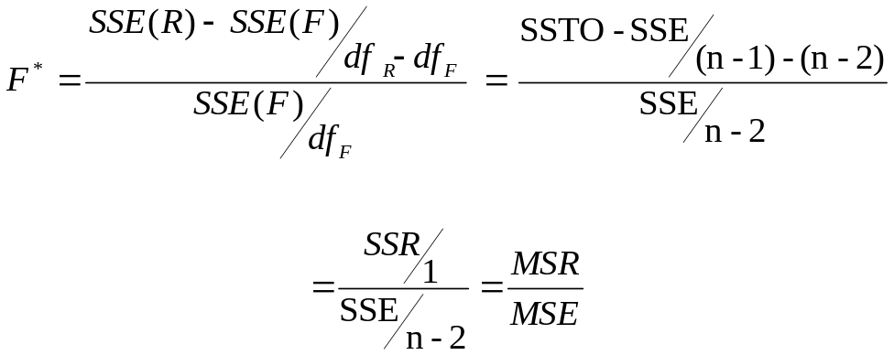
General Linear
Test Approach
which is identical to the ANOVA F test statistic. Thus for simple linear regression, the general linear F statistic is the same as the regular ANOVA F statistic. This is just for the simple linear example and is not always the case.

Slide 11
General Linear
Test Approach
The general linear test approach can also be used for highly complex tests of linear statistical models, as well as for simple tests. The basic steps are:
Fit the full model and obtain the error sum of squares SSE(F).
Fit the reduced model under H_{o} and obtain the error sum of squares SSE(R).
Use the test statistic F* and the appropriate decision rule (or obtain the corresponding p-value).

Slide 12
Descriptive Measures of Association
There are times when the degree of linear association between X and Y is of interest and we will discuss two descriptive measures that are frequently used.
Recall that the SSTO measures the variation in the observations when the predictor variable is not taken into account.
Similarly, the SSR measures the variation in the observations explained by X.

Slide 13
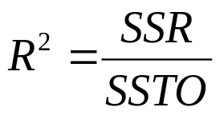
Descriptive Measures of Association
A natural measure of the effect of X on the variation in Y is to express the explained variation as a proportion of total variation.
The measure R² is called the coefficient of determination.
Since 0 ≤ SSR ≤ SSTO, it follows that 0 ≤ R² ≤ 1.

Slide 14
Descriptive Measures of Association
R² is the ratio of the explained variation to the total variation.
We can interpret R² as the proportion of the total variation that is accounted for by the use of the predictor variable X.
When all the observations fall on the regression line, then the model explains all of the variation in Y and SSR = SSTO and R² = 1. Thus R² = 1 corresponds with a perfect linear association in our data.
R² = 0 corresponds with no linear association between X and Y in our data.

Slide 15
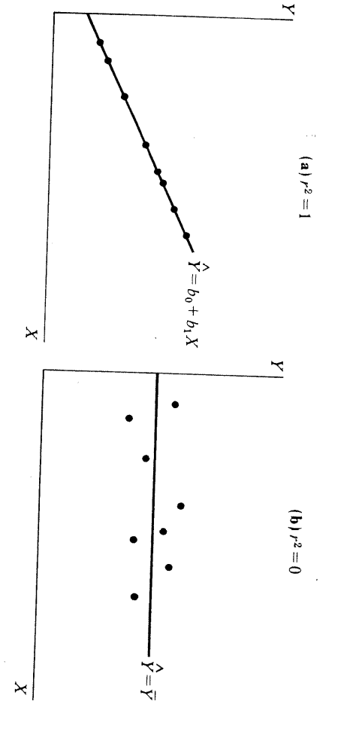
Descriptive Measures of Association
R² = 1 corresponds with a perfect linear association in our data.
R² = 0 corresponds with no linear association between X and Y in our data.

Slide 16

Descriptive Measures of Association
The square root of R²:
is called the coefficient of correlation.
A plus or minus sign is attached to this measure according to whether the slope of the regression line is positive or negative. Thus -1 ≤ r ≤ 1.
The slope b₁ of the regression equation tells us the direction of the association between X and Y. The slope however does not directly tell us the strength of the association.

Slide 17
Descriptive Measures of Association
The reason for this is that the slope’s numerical value is intrinsically linked to the units of measurements.
For example, consider a regression equation:
y(hat) =10+X
where Y = amount of icecream eaten in pounds and X = temperature.
For every unit increase in temperature, the expected amount of icecream eaten goes up by 1 pound (b₁ =1).
This is equivalent to the expected amount of icecream eaten going up by 16 ounces.

Slide 18
Descriptive Measures of Association
So if icecream is measured in ounces instead of pounds, the slope is 16 and not 1 (b₁ =16). The regression equation is then:
y(hat) =10+16X
The strength of the association are the same in both cases, since the variables and the data are the same. Only the units of measurement for Y differed.
The estimated slope b₁ doesn’t directly indicate whether the association is strong or weak, because we can make b₁ as large or as small as we like by an appropriate choice of units.
The correlation is a standardized version of the slope. Its value does not depend on the units of measurement.

Slide 19
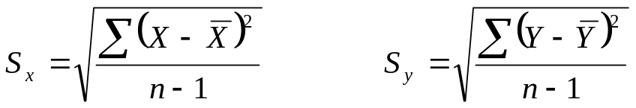
Descriptive Measures of Association
The standardization adjusts the estimated slope b₁ for the fact that the standard deviations of X and Y depend on their units of measurement.
The correlation is the value the slope would take for units such that the variables X and Y have the same standard deviations.
Let S_{x} and S_{y} denote the sample standard deviations of X and Y,

Slide 20
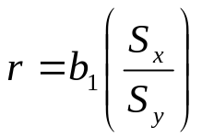
Descriptive Measures of Association
An alternative formula for r is
When the sample standard deviations are equal, that is when S_{x}= S_{y}, then r = b₁.
For example, if we standardize both variables by converting their values to z scores, both variables will have a standard deviation of 1. If we ran a regression on the transformed variables then r and b₁ will be the same.
Because of the relationship between r and b₁, the correlation is also called the standardized regression coefficient.

Slide 21
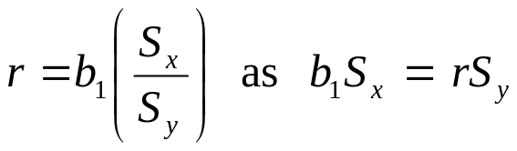
Descriptive Measures of Association
Another interpretation of the correlation relates to its standardized slope property. We can rewrite the equality
Since the slope b₁ is the change in y(hat) for a one unit increase in X, S_{x} b₁ is the change in y(hat) for a S_{x} increase in X.
For example, if the slope is 10 and we increase X by 2 units, then the value of y(hat) goes up by 2*10 units. If we increase X by S_{x} units, the value of y(hat) goes up by S_{x}*10 units, which is S_{x}*b₁ units.

Slide 22
Descriptive Measures of Association
Since S_{x} b₁ = r S_{y}, and S_{x} b₁ equals the change in y(hat) for a S_{x} increase in X, r S_{y} equals the change in y(hat) for a S_{x} increase in X.
Thus, the amount of change in y(hat) for a S_{x} increase in X is equal to a certain proportion of S_{y}. Or the amount of change in y(hat) for a S_{x} increase in X is equal to r of S_{y} (that is it equals r times S_{y} ).
So if r=1, the change in the predicted value of Y for a one standard deviation change in X is one standard deviation of Y.
If r=.5, the change in the predicted value of Y for a one standard deviation change in X is a half a standard deviation of Y.

Slide 23
Descriptive Measures of Association
For example, in the 1800’s Sir Francis Galton studied the relationship between X=parent height (the average of both parents) and Y = child's height.
After multiplying each female height by 1.08 to account for gender differences, he noted that the correlation between X and Y was about .5.
From the property just discussed, a standard deviation change in parent height corresponds to half a standard deviation change in the child’s predicted height.
For parents of average height, the child’s height is predicted to be average.

Slide 24
Descriptive Measures of Association
If on the other hand, parent height is a standard deviation above average, the child is predicted to be half a standard deviation above average.
If parent height is two standard deviations below average, the child is predicted to be one standard deviation below average.
Since r is less than 1, a y-value is predicted to be fewer standard deviations from its mean than x is from its mean.
Tall parents tend to have tall children, but on the average, not quite as tall as the parents.

Slide 25
Descriptive Measures of Association
For instance, if you consider all fathers with height 7 feet, perhaps the average height of their sons is 6 feet 5 inches – taller than average, but not so extremely tall as the parents.
This is called regression toward the mean and is the origin of the name for regression analysis.

Slide 26
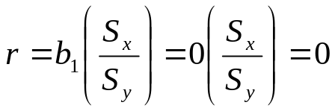
Descriptive Measures of Association
Instead of doing inferences on b₁, we can do inferences on r. Recall that, b₁ = 0 corresponds to no linear association between X and Y in the data.
If b₁ = 0, r will also be 0.

Slide 27
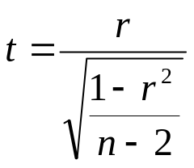
Descriptive Measures of Association
Let ρ denote the true correlation between X and Y (just as β₁ denotes the true slope). We estimate ρ with r.
If there is no linear association between X and Y then not only will β₁ = 0, but so will ρ.
A test of H_{o}: ρ = 0 using the sample value r, is equivalent to the t test of H_{o}: β₁ = 0 using the sample value b₁.
The test statistic is

Slide 28
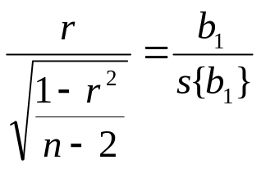
Descriptive Measures of Association
This statistic provides the same value as the t statistic based on b₁. That is
Either statistic can be used to test if Y is linearly related to X since both have a t distribution with n-2 degrees of freedom and both yield the exact same p-value. They are both the exact same test.

Slide 29
Descriptive Measures of Association
Except for when R² = 1 or 0, |r| will be greater than R².
This can give the impression of a stronger linear relationship between X and Y.
For example, if R² = .1, then the use of the predictor X in the regression model only accounts for 10% of the total variation.
Yet, |r| = .32 may give an impression of greater linear association between X and Y.

Slide 30
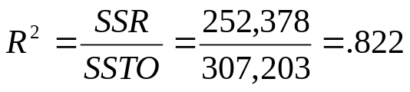

Descriptive Measures of Association
For the Toluca example, we had that SSTO = 307,203 and SSR = 252,378. Therefore:
Thus, the use of lot size in the regression model accounts for 82.2% of the total variation in work hours.
The correlation coefficient here is (the plus sign is from the fact b₁ > 0)
SAS: r

